Slide 1


Data Harmonization and Insights Extraction
Project 2: Analysis of Ride Data
Alegapalli Kalavathi
26th Dec 2024

Slide 2

Introduction:
The goal of this project is to be clean and prepare dataset for analysis.
Data used:-
Dataset_1[dataset_1 - Google Sheets], Dataset_2[dataset_2.xlsx - Google Sheets], and Dataset_3 [dataset_3 - Google Sheets]

Slide 3
Dataset Overview
Dataset Attributes:
Date
Season_type
Holiday
Working Day
Weather
Temperature
Atemperature
Windspeed
Non-Registered rentals
Registered rentals
Total rentals
Data Sources:
The datasets were sourced from the NEXTHIKES IT Solution which gives us the internship program and this project gave by the mentor.

Slide 4
Datasets Information:
Dataset_1 Overview: Dataset_1 contains Ride records with attributes instant, dteday ,season,yr, mnth,hr, holiday, weekday, weathersit, temp .
Dataset_2 Characteristics: Dataset_2 comprises instant, atemp, hum,windspeed,casual, registered,cnt. Dataset_3 Attributes: Dataset_3 features product details such instant, dteday ,season,yr, mnth,hr, holiday, weekday, weathersit, temp, instant, atemp, hum,windspeed,casual, registered,cnt.

Slide 5
Problem Statement
Outline the challenges faced with the datasets :
Changing the dataset as per attributes.
Missing values.
Drop unnecessary columns.
Arranging the data in sequential order.
Detection and Treatment of outliers.

Slide 6
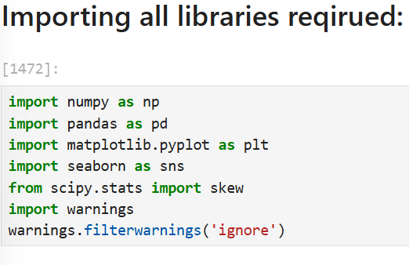
Data Acquisition
Methods Used:
import numpy as np
import pandas as pd
from scipy.stats import skew
import matplotlib.pyplot as plt
import seaborn as sns
Import warnings

Slide 7

Data Wrangling Techniques
Dataset Integration: Successfully integrated Dataset_1 with Dataset_2, establishing a foundational layer for comprehensive analysis.
Addressing Missing Values: Implemented imputation techniques to effectively manage and resolve missing values in Dataset_3 during integration.
Sorting data: Sorting data in sequential order in incremental order of date and Ride_id
Outliers Management: Identified and treated outliers within the datasets, enhancing overall data quality for reliable insights.

Slide 8
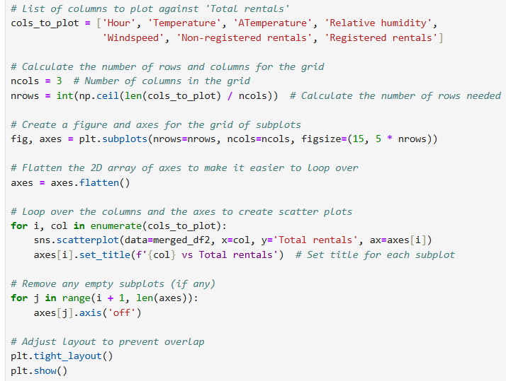
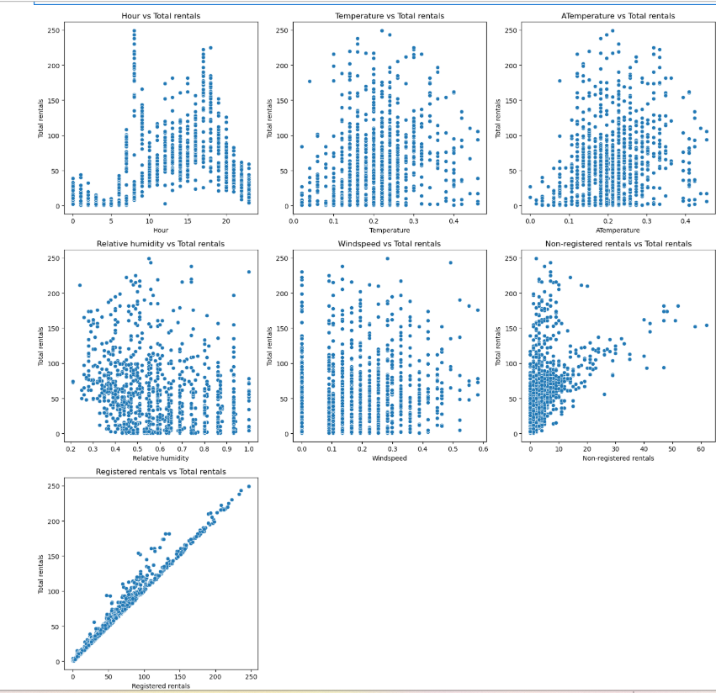
Scatterplots

Slide 9
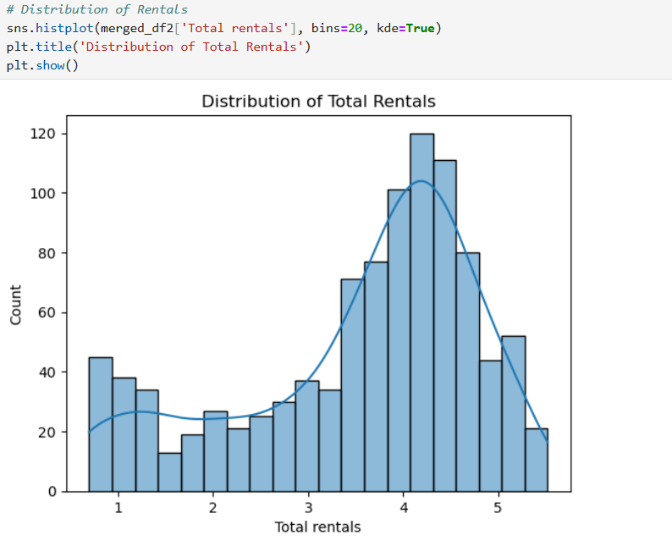
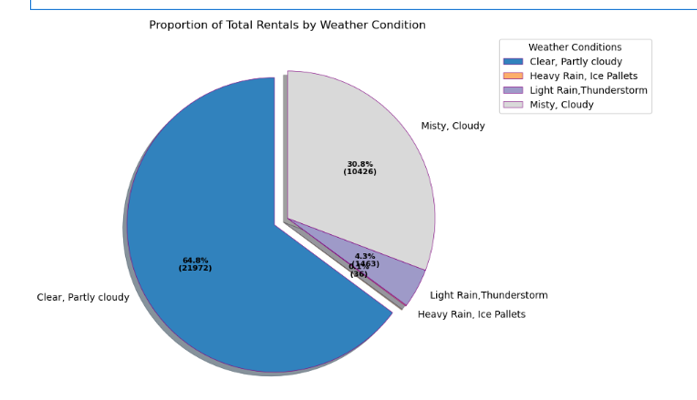
Distribution of Total rentals:

Slide 10
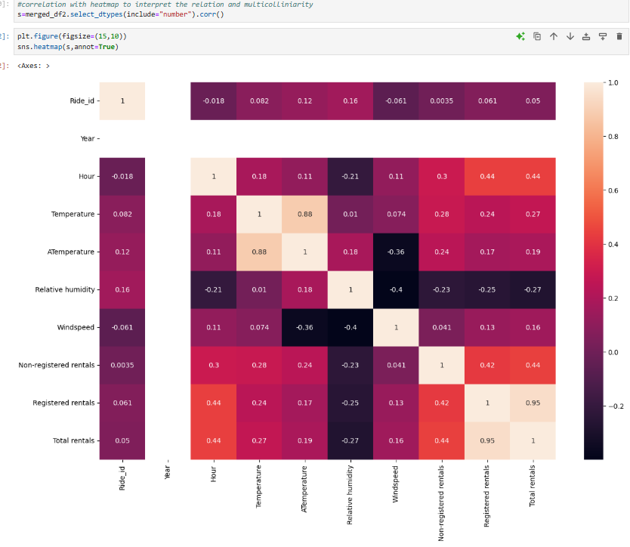
Correlation with heatmap to interpret the relation and multicolliniarity:

Slide 11
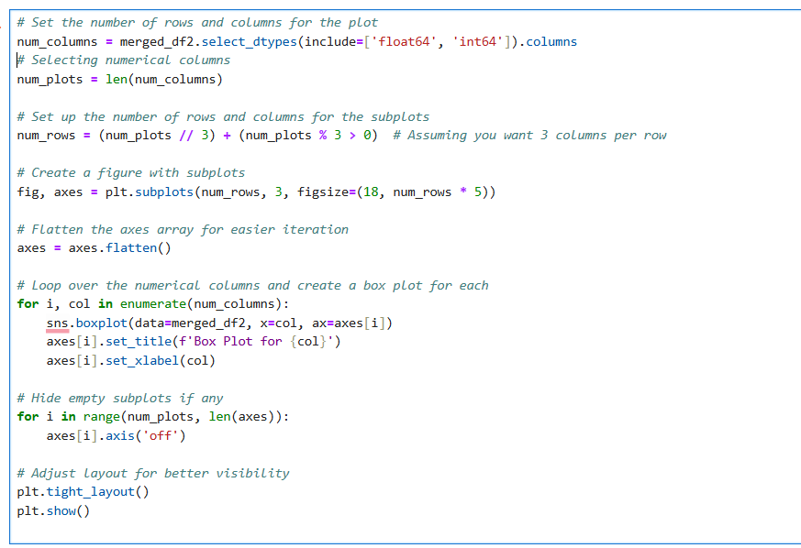
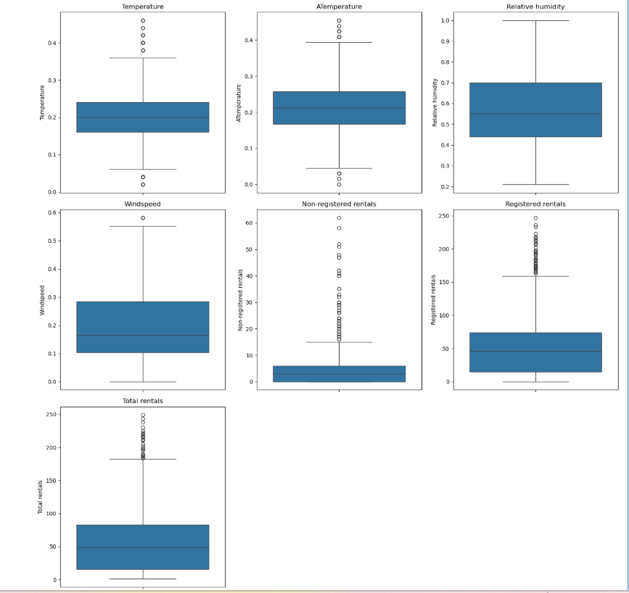
Visualising outliers through Boxplot:

Slide 12
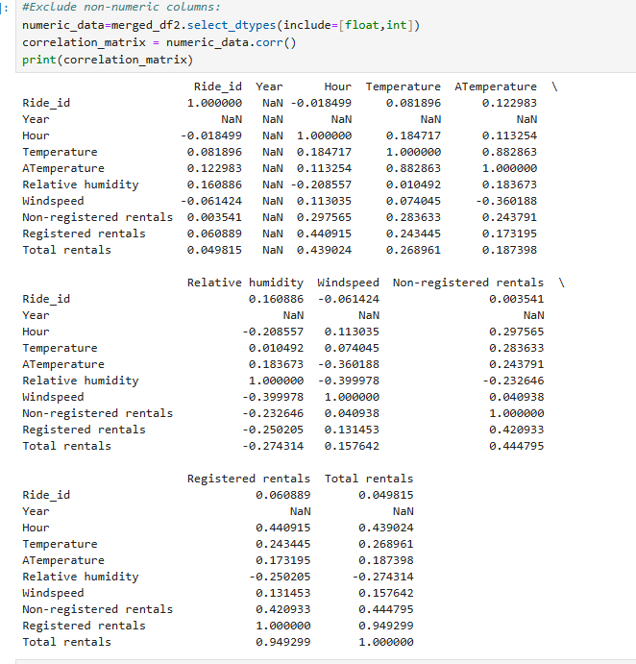
Correlation
Findings :
Present a correlation matrix

Slide 13
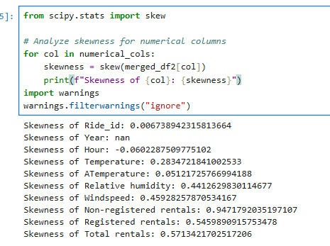
Skewness:
Findings :
Display skewness values.

Slide 14
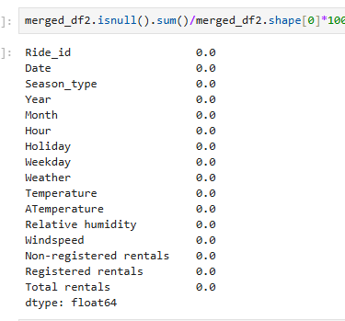
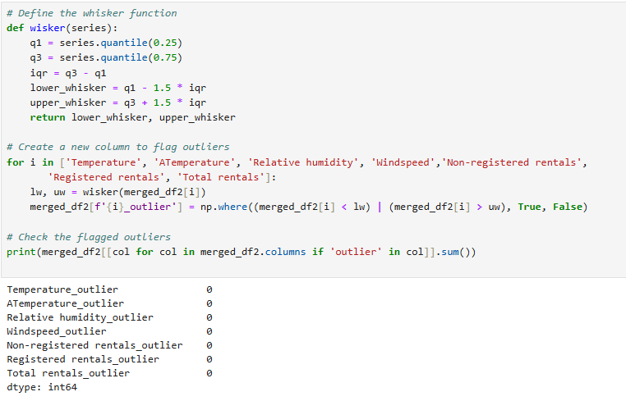
Final Dataset Summary
Shape and Data Types:
Display the shape of the final data
Show a summary of data types.

Slide 15
Conclusion
Merged Dataset: The final merged dataset integrates diverse inputs, optimized
for effective analytical and reporting capabilities.
Jupyter Notebook for Analysis: A comprehensive Jupyter Notebook is provided
facilitating reproducible analysis and detailed documentation of methodologies.
Resources Accessibility: All project resources, including the PowerPoint presentation and
code, are accessible via a dedicated GitHub repository.

Slide 16
References:
https://www.geeksforgeeks.org/data-analysis-visualization-python/?ref=gcse_ind
http://pandas.pydata.org/pandas-docs/stable/tutorials.html
https://www.datacamp.com
https://www.geeksforgeeks.org/data-wrangling-in-python/?ref=gcse_ind
https://www.youtube.com/watch?v=cN3i8ktEg54&list=PLq7bAUXvGrZX8OEg3UBXKT3Fr10Ilvp9P&index=5

Slide 17


